Slide 1
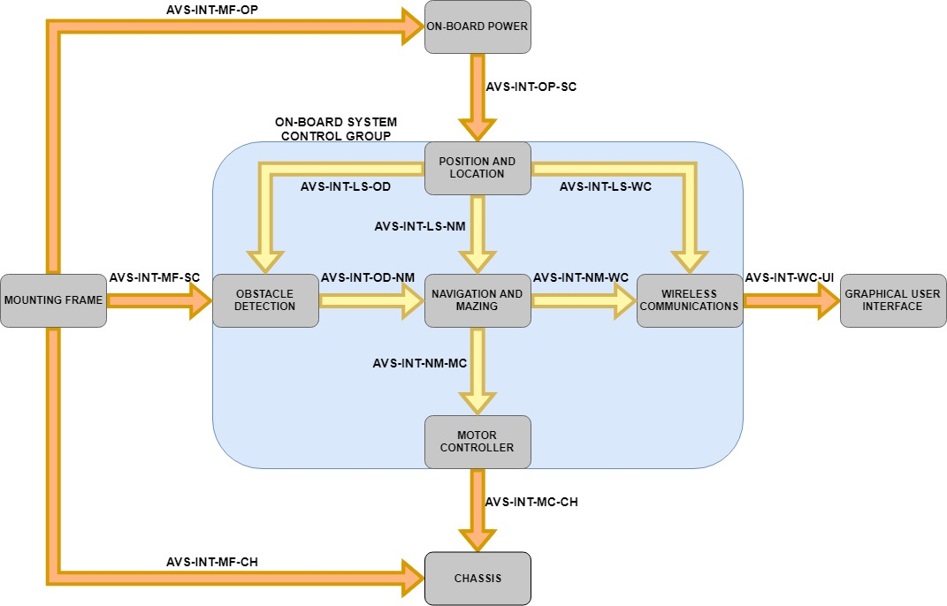
Obstacle Detection System - Context

Slide 2
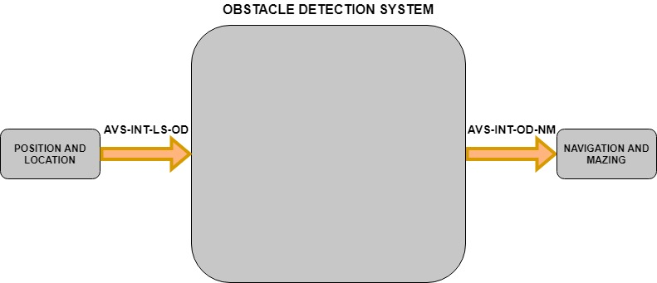
Obstacle Detection System – Black box
Purpose: To detect and locate obstacles to allow more informed navigation decisions.
Requirements:
Detect obstacles within the range constraints of the HC-SR04 sensors (2cm – 400cm)
Output the grid reference location of detected obstacles to the navigation system

Slide 3
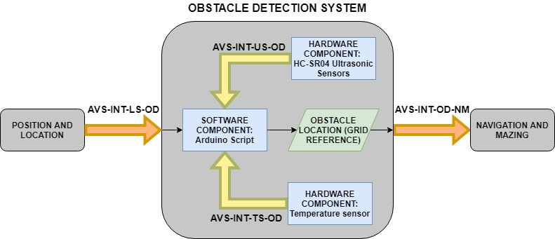
Obstacle Detection System - Internal
*if required*

Slide 4
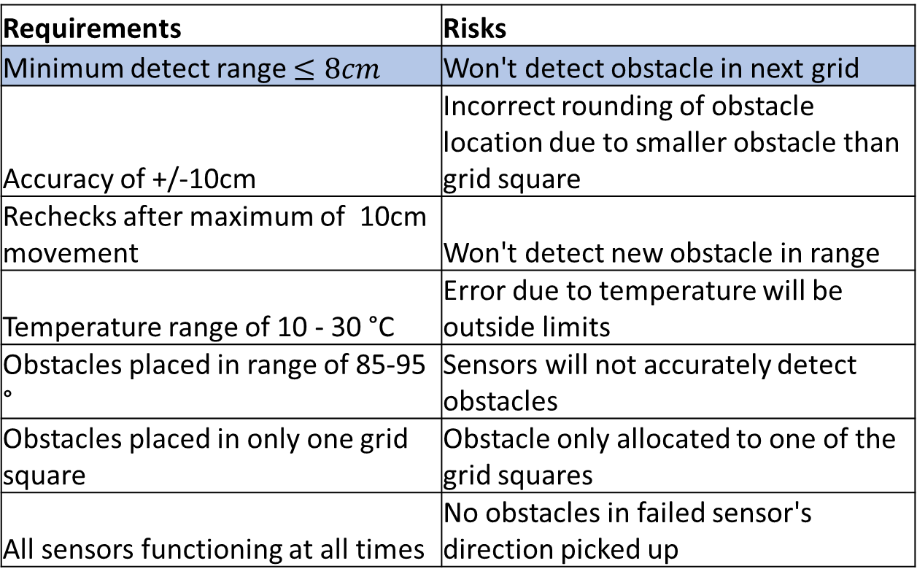
Obstacle Detection System - Risks
Requirements | Risks
Minimum detect range $≤8cm$ | Won't detect obstacle in next grid
Accuracy of +/-10cm | Incorrect rounding of obstacle location due to smaller obstacle than grid square
Rechecks after maximum of 10cm movement | Won't detect new obstacle in range
Temperature range of 10 - 30 °C | Error due to temperature will be outside limits
Obstacles placed in range of 85-95 ° | Sensors will not accurately detect obstacles
Obstacles placed in only one grid square | Obstacle only allocated to one of the grid squares
All sensors functioning at all times | No obstacles in failed sensor's direction picked up
Mitigation
Have minimum offset from vehicle as possible

Slide 5
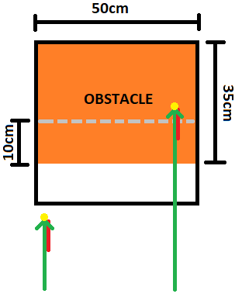
Obstacle Detection System - Risks
Requirements | Risks
Minimum detect range = 10cm | Won't detect obstacle in next grid
Accuracy of +/-10cm | Incorrect rounding of obstacle location due to smaller obstacle than grid square
Rechecks after maximum of 10cm movement | Won't detect new obstacle in range
Temperature range of 10 - 30°C | Error due to temperature will be outside limits
Obstacles placed in range of 85-95° | Sensors will not accurately detect obstacles
Obstacles placed in only one grid square | Obstacle only allocated to one of the grid squares
All sensors functioning at all times | No obstacles in failed sensor's direction picked up
Mitigation
Add negative distance bias such that rounding will be correct

Slide 6
Obstacle Detection System - Risks
Requirements | Risks
Minimum detect range = 10cm | Won't detect obstacle in next grid
Accuracy of +/-10cm | Incorrect rounding of obstacle location due to smaller obstacle than grid square
Rechecks after maximum of 10cm movement | Won't detect new obstacle in range
Temperature range of 10 - 30 °C | Error due to temperature will be outside limits
Obstacles placed in range of 85-95 ° | Sensors will not accurately detect obstacles
Obstacles placed in only one grid square | Obstacle only allocated to one of the grid squares
All sensors functioning at all times | No obstacles in failed sensor's direction picked up
Mitigation
Detect every 1cm based on max speed (TBC)

Slide 7
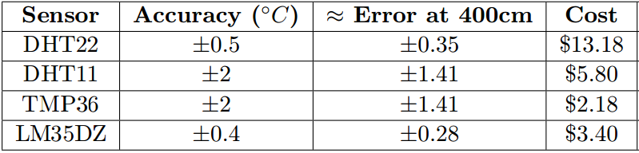
Obstacle Detection System - Risks
Requirements | Risks
Minimum detect range = 10cm | Won't detect obstacle in next grid
Accuracy of +/-10cm | Incorrect rounding of obstacle location due to smaller obstacle than grid square
Rechecks after maximum of 10cm movement | Won't detect new obstacle in range
Temperature range of 10 - 30 °C | Error due to temperature will be outside limits
Obstacles placed in range of 85-95 ° | Sensors will not accurately detect obstacles
Obstacles placed in only one grid square | Obstacle only allocated to one of the grid squares
All sensors functioning at all times | No obstacles in failed sensor's direction picked up
Mitigation

Slide 8
Obstacle Detection System - Risks
Requirements | Risks
Minimum detect range = 10cm | Won't detect obstacle in next grid
Accuracy of +/-10cm | Incorrect rounding of obstacle location due to smaller obstacle than grid square
Rechecks after maximum of 10cm movement | Won't detect new obstacle in range
Temperature range of 10 - 30 °C | Error due to temperature will be outside limits
Obstacles placed in range of 85-95 ° | Sensors will not accurately detect obstacles
Obstacles placed in only one grid square | Obstacle only allocated to one of the grid squares
All sensors functioning at all times | No obstacles in failed sensor's direction picked up
Mitigation
Introduce a sweeping technique

Slide 9
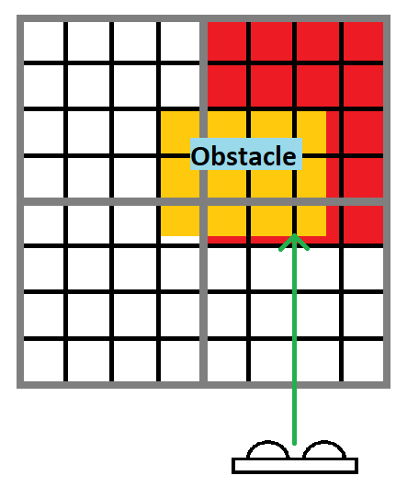
Obstacle Detection System - Risks
Requirements | Risks
Minimum detect range = 10cm | Won't detect obstacle in next grid
Accuracy of +/-10cm | Incorrect rounding of obstacle location due to smaller obstacle than grid square
Rechecks after maximum of 10cm movement | Won't detect new obstacle in range
Temperature range of 10 - 30 °C | Error due to temperature will be outside limits
Obstacles placed in range of 85-95 ° | Sensors will not accurately detect obstacles
Obstacles placed in only one grid square | Obstacle only allocated to one of the grid squares
All sensors functioning at all times | No obstacles in failed sensor's direction picked up
Mitigation
Implement smaller detection grid-squares for higher resolution

Slide 10
Obstacle Detection System - Risks
Requirements | Risks
Minimum detect range = 10cm | Won't detect obstacle in next grid
Accuracy of +/-10cm | Incorrect rounding of obstacle location due to smaller obstacle than grid square
Rechecks after maximum of 10cm movement | Won't detect new obstacle in range
Temperature range of 10 - 30 °C | Error due to temperature will be outside limits
Obstacles placed in range of 85-95 ° | Sensors will not accurately detect obstacles
Obstacles placed in only one grid square | Obstacle only allocated to one of the grid squares
All sensors functioning at all times | No obstacles in failed sensor's direction picked up
Mitigation
If upon testing it is noticed that sensors have intermittent response, add redundancy (multiple sensors in same direction)

